Slide 1
Phenomenon-Based Learning
Third Grade

Slide 2


OWL Tracker Introduction
Observe ~ Wonder ~ Learn
The following pictures were taken on the same day of the same plant from different angles.
Notes:
If your students are unfamiliar with phenomenon-based learning, use the following pictures a supplemental activity to build student’s observation and questioning skills. See pages XIII and XIV in Module 1 Robobees Teacher Manual for possible guiding questions and student handout.

Slide 3
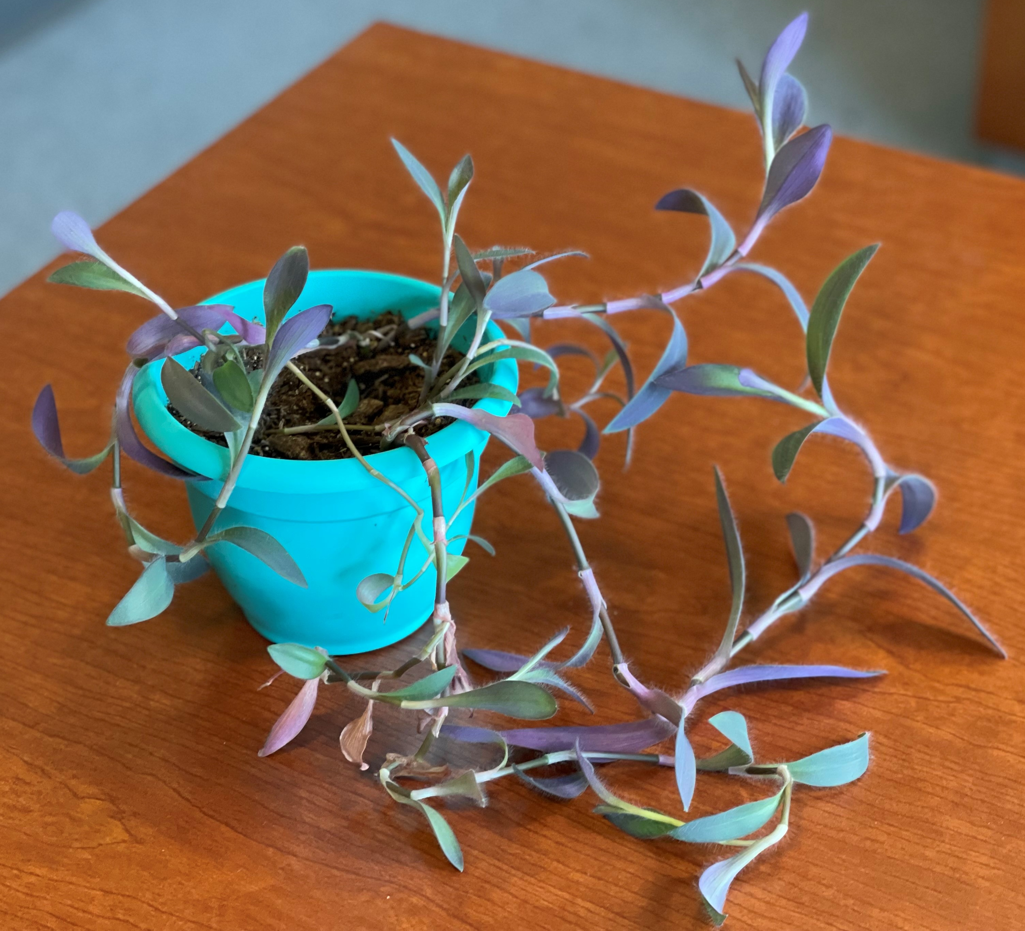
O B S E R V E
Notes:
What facts do you see?

Slide 4
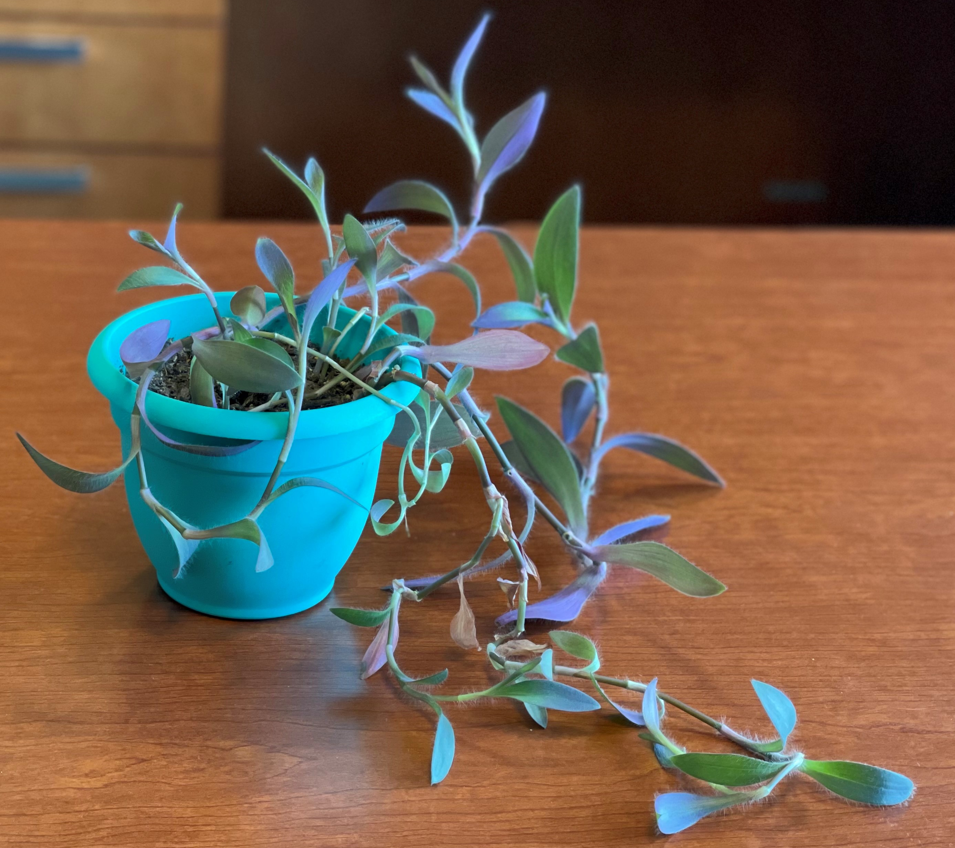
W
O N
D E R
Notes:
What questions do you have? As you think of questions, do you notice any more facts to add to your observations?

Slide 5
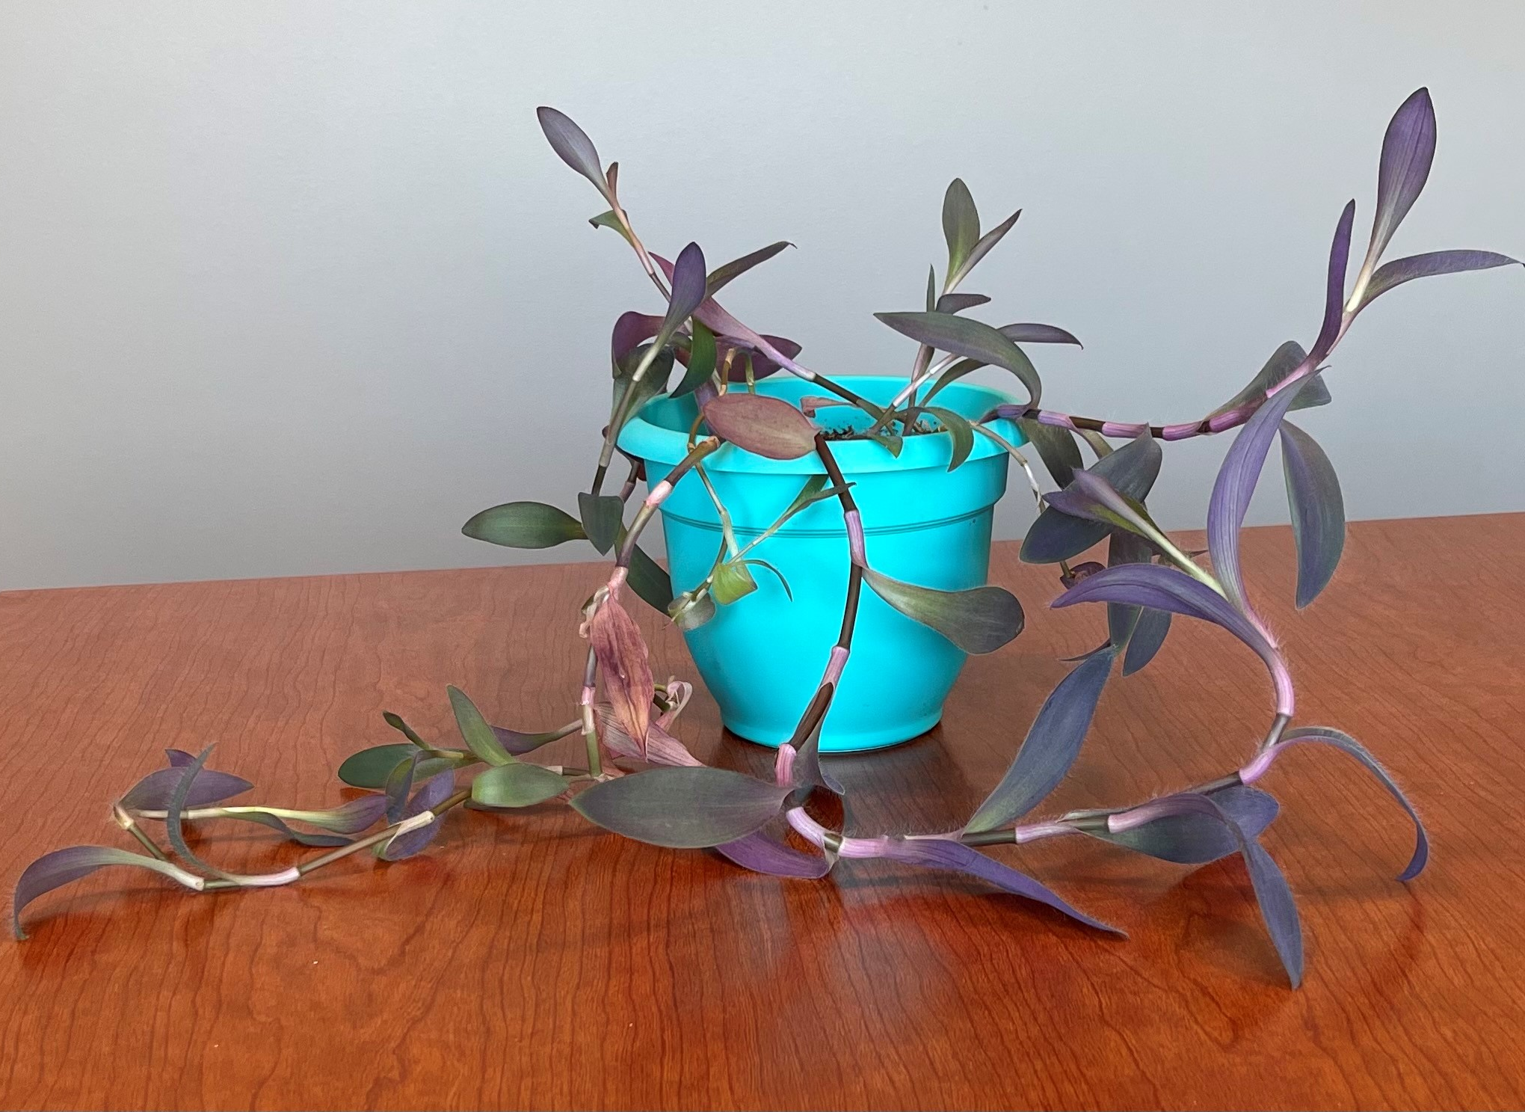
Notes:
These three pictures were taken on the same day of the same plant from different angles. Why is it important to observe an object a carefully from different sides?

Slide 6
Module 1
Anchor Phenomenon

Slide 7
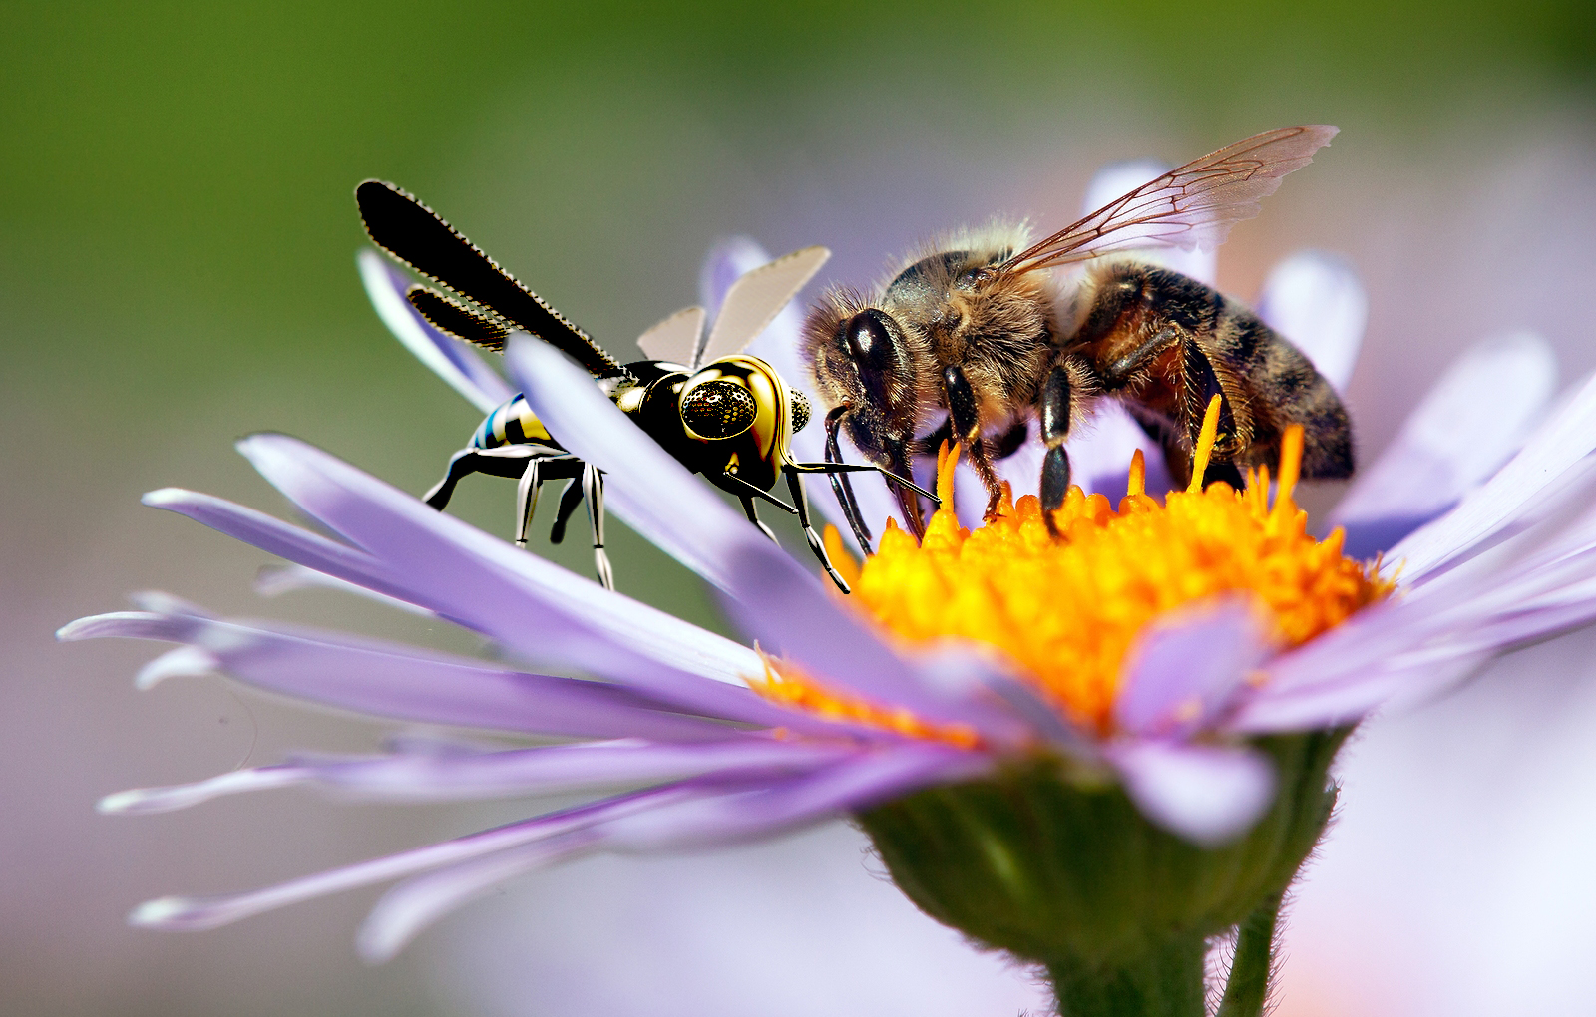

Slide 8
Discovery 1
Investigative Phenomenon

Slide 9
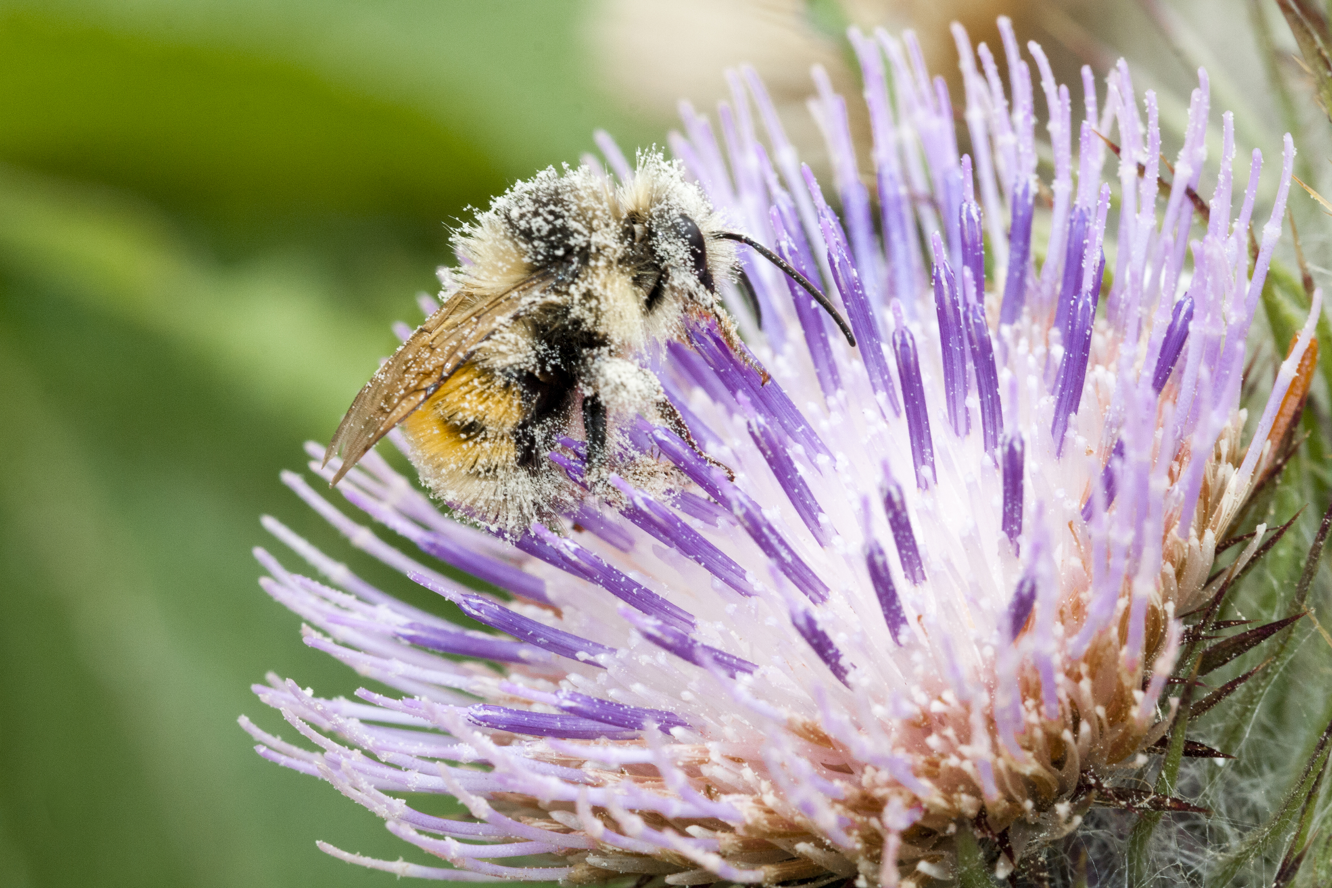

Slide 10
Discovery 2
Investigative Phenomenon

Slide 11
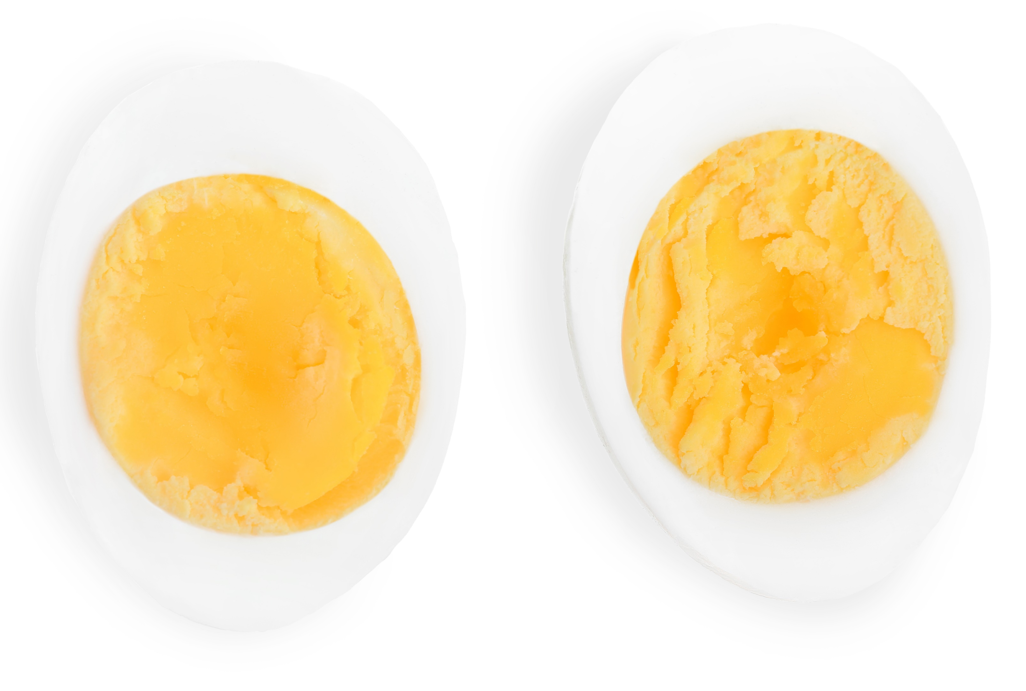
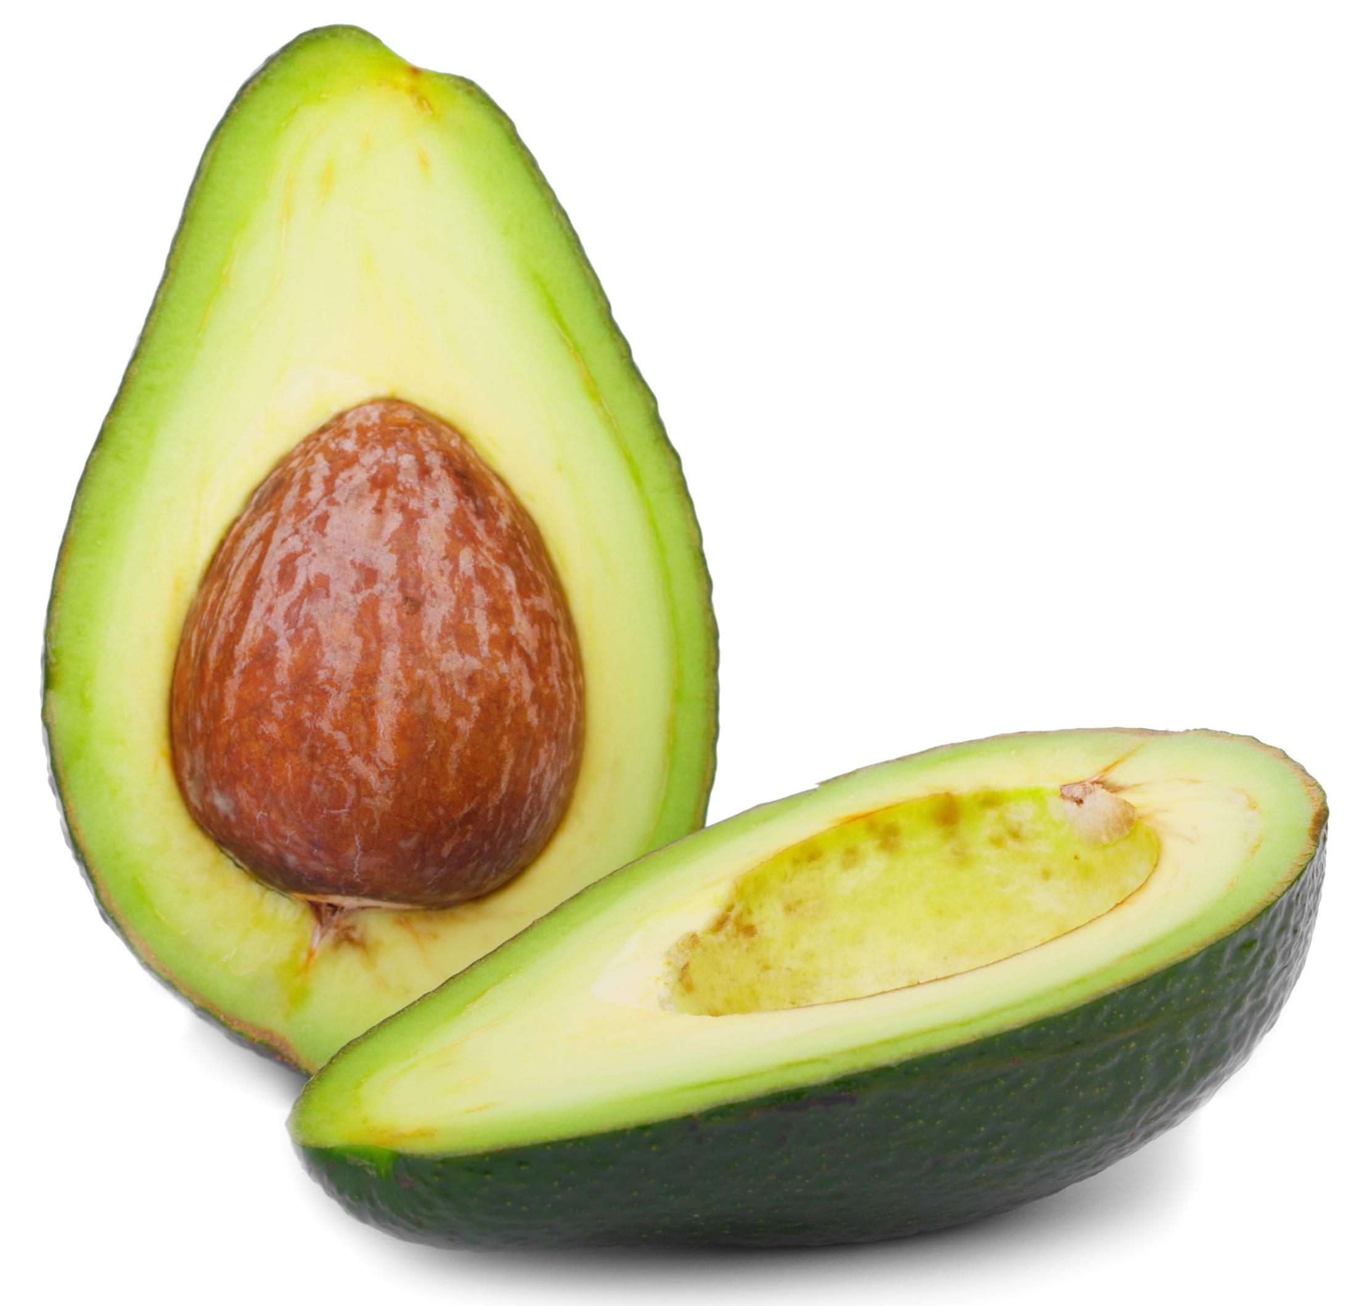

Slide 12
Discovery 3
Investigative Phenomenon

Slide 13
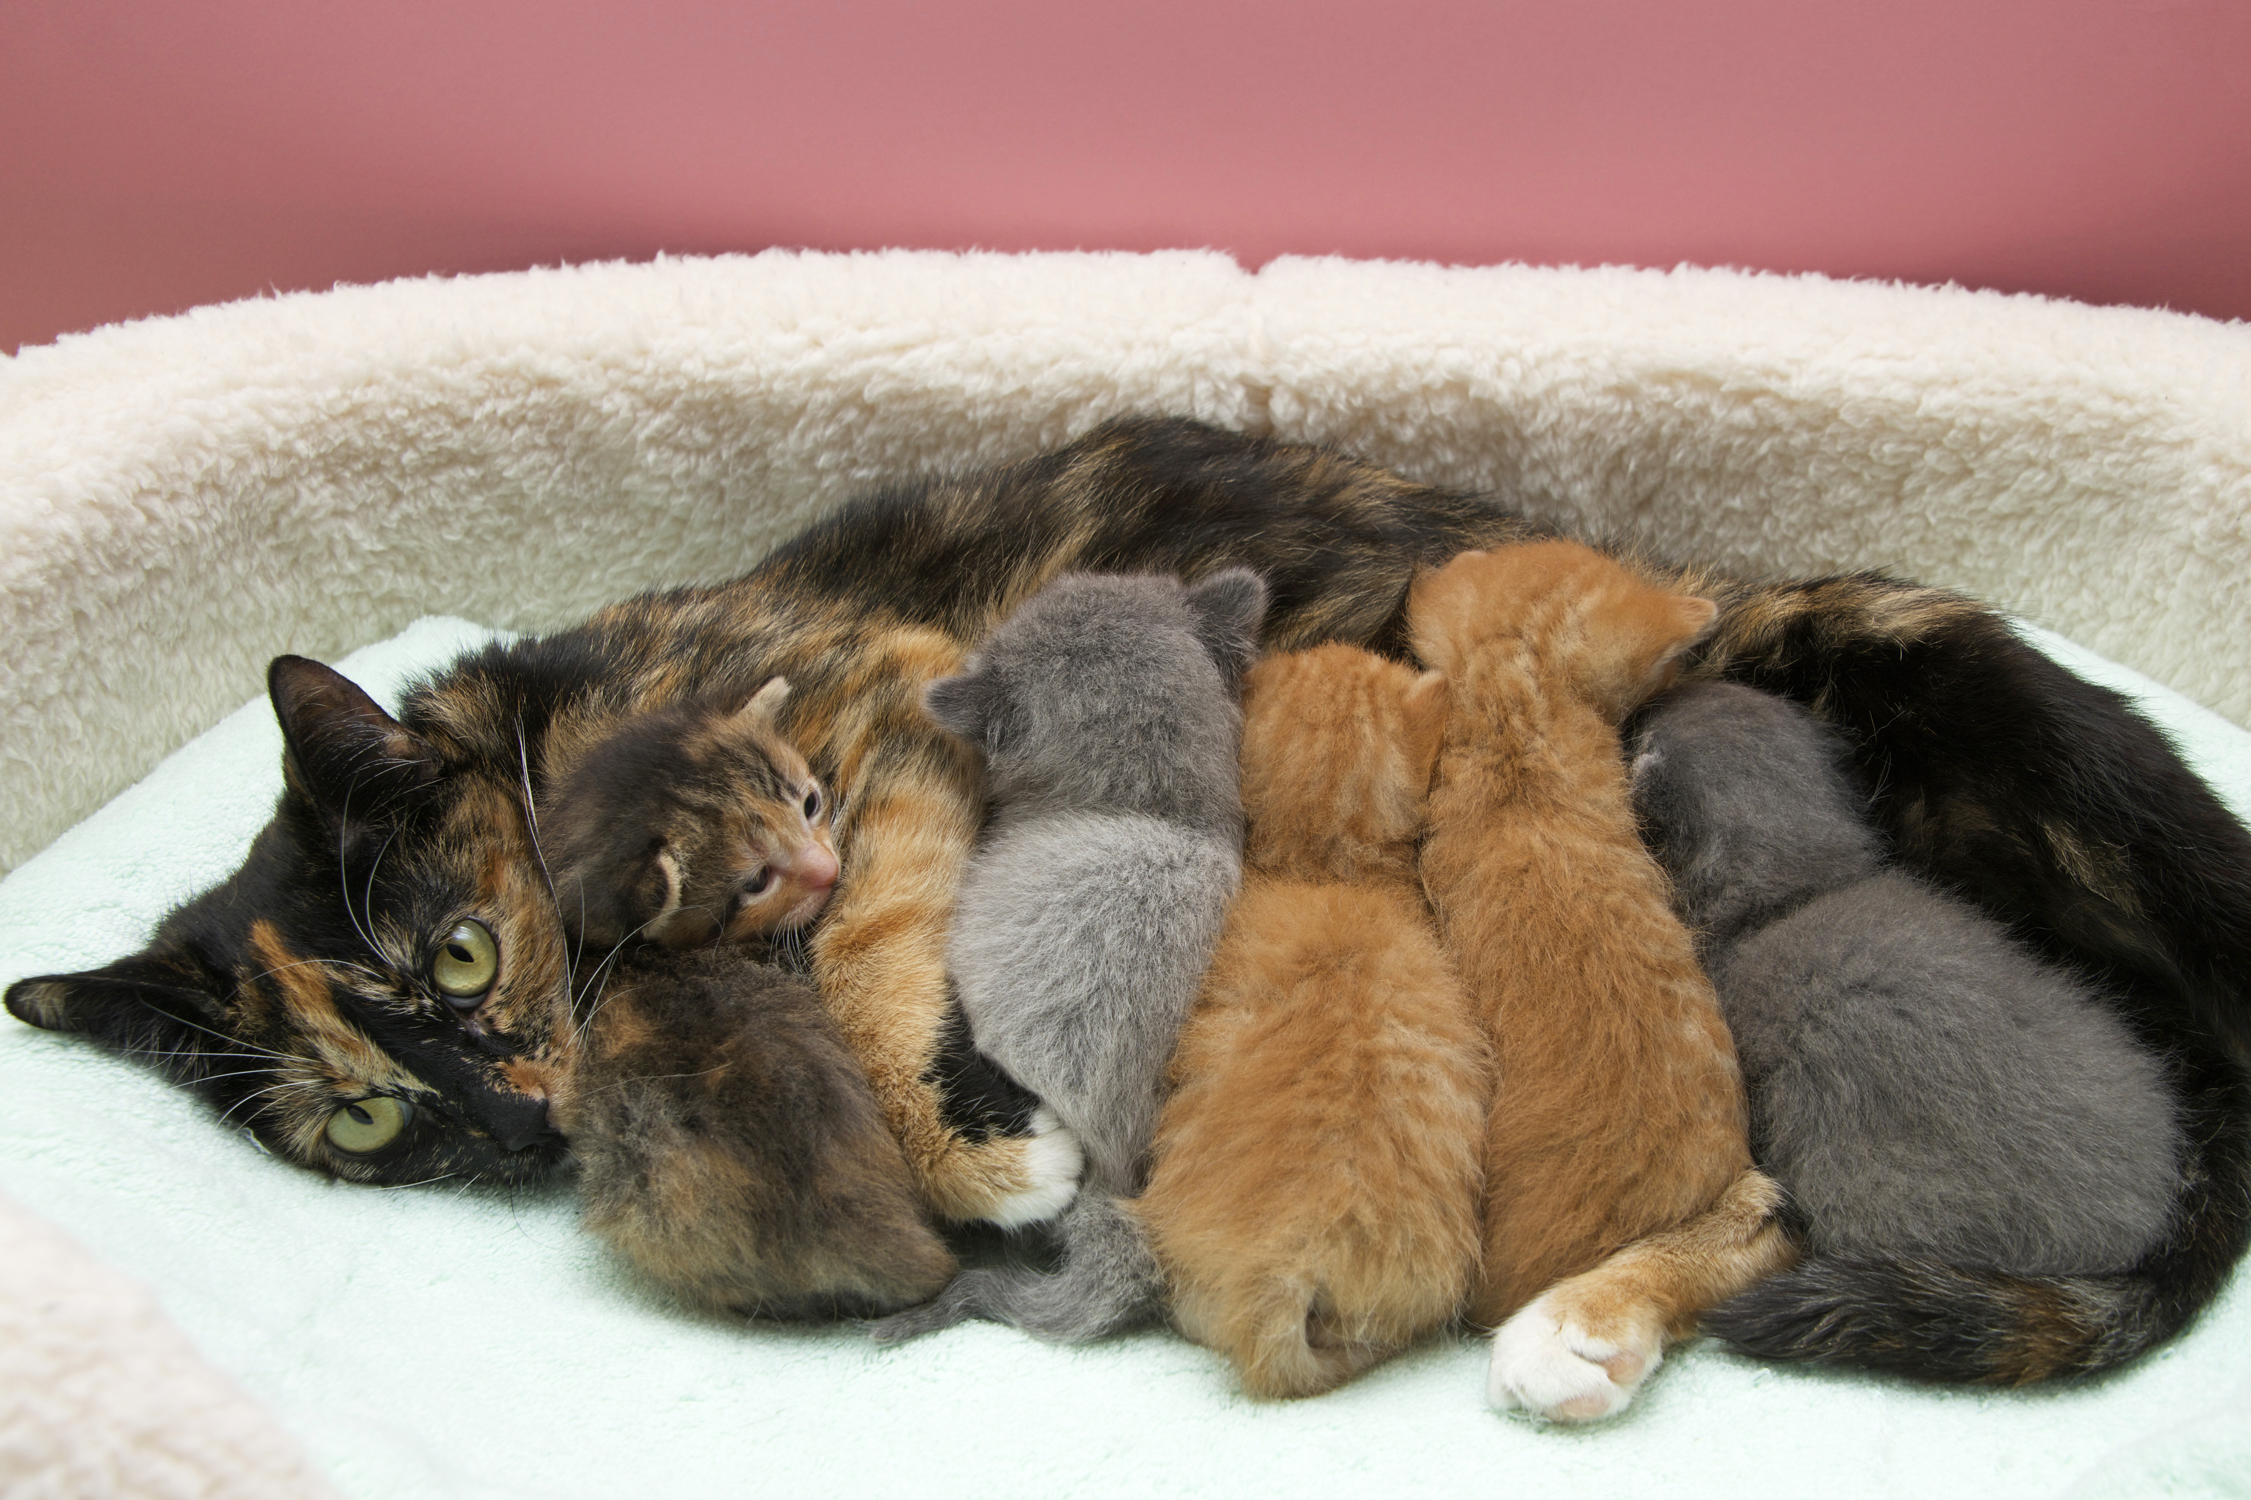

Slide 14
Discovery 4
Investigative Phenomenon

Slide 15
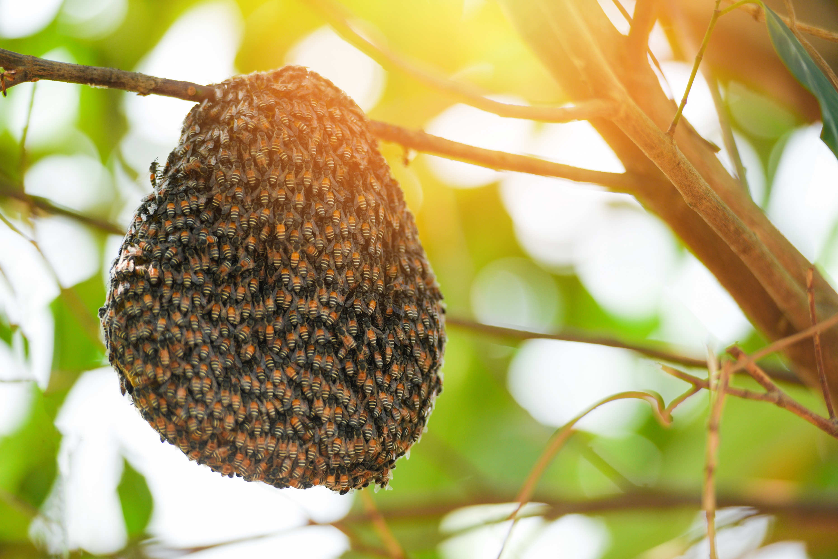

Slide 16
Discovery 5
Investigative Phenomenon

Slide 17
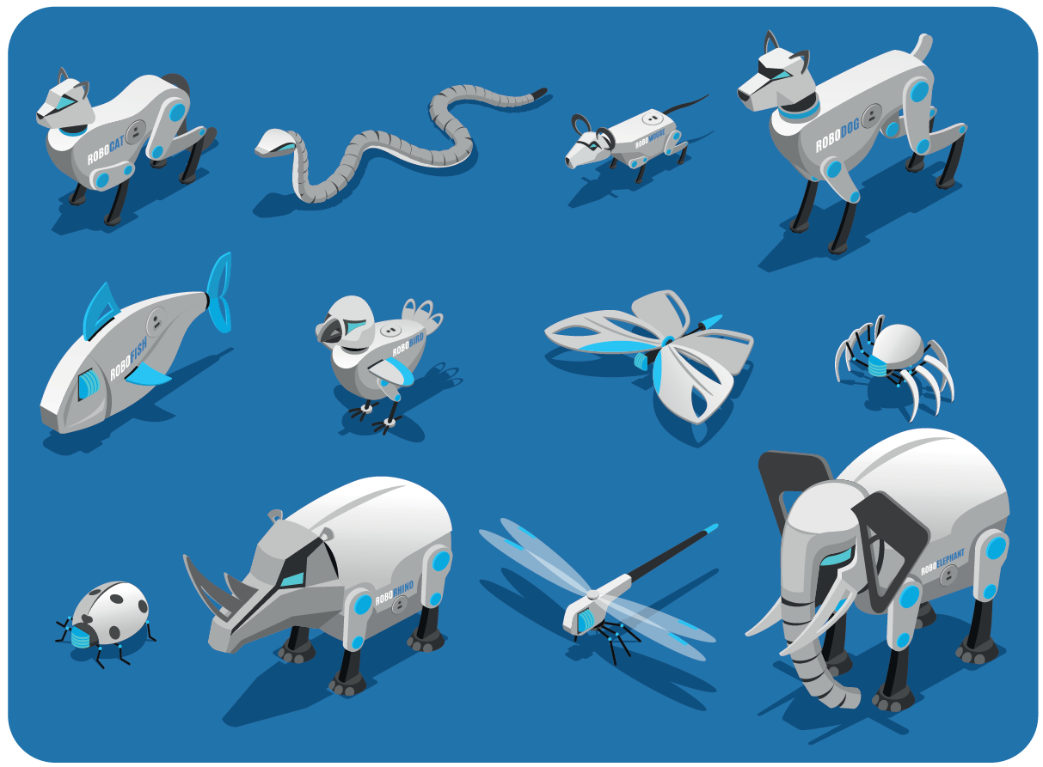
Hashem Al-Ghalili, “Robots Inspired by Nature” https://www.youtube.com/watch?v=drQP_0yaMXE

Slide 18
Module 2
Anchor Phenomenon

Slide 19
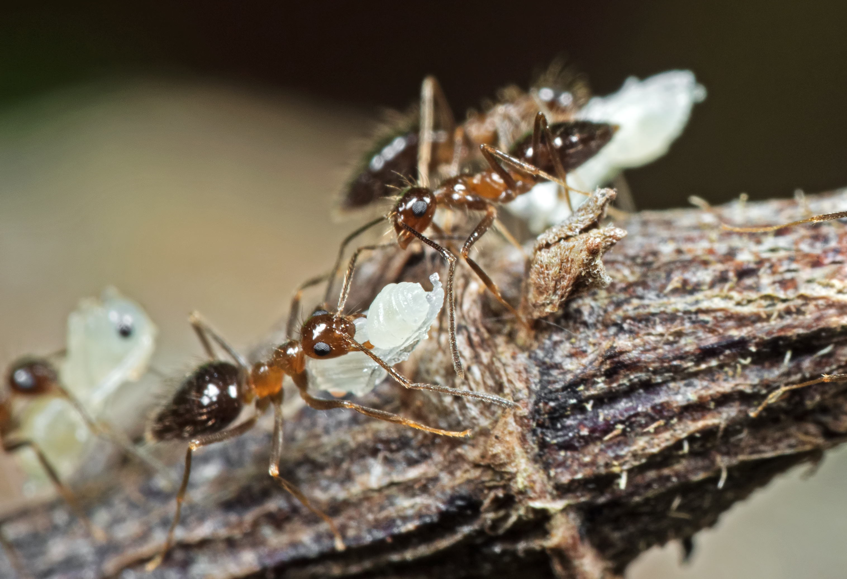
AL.com, “Floating Fire Ants”
https://www.youtube.com/watch?v=CXnQd6hhFOo
Notes:
https://www.youtube.com/watch?v=CXnQd6hhFOo

Slide 20
Discovery 1
Investigative Phenomenon

Slide 21
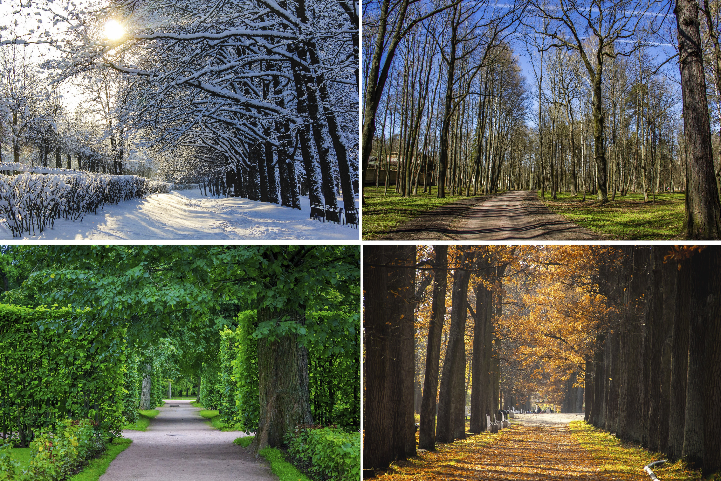

Slide 22
Discovery 2
Investigative Phenomenon

Slide 23
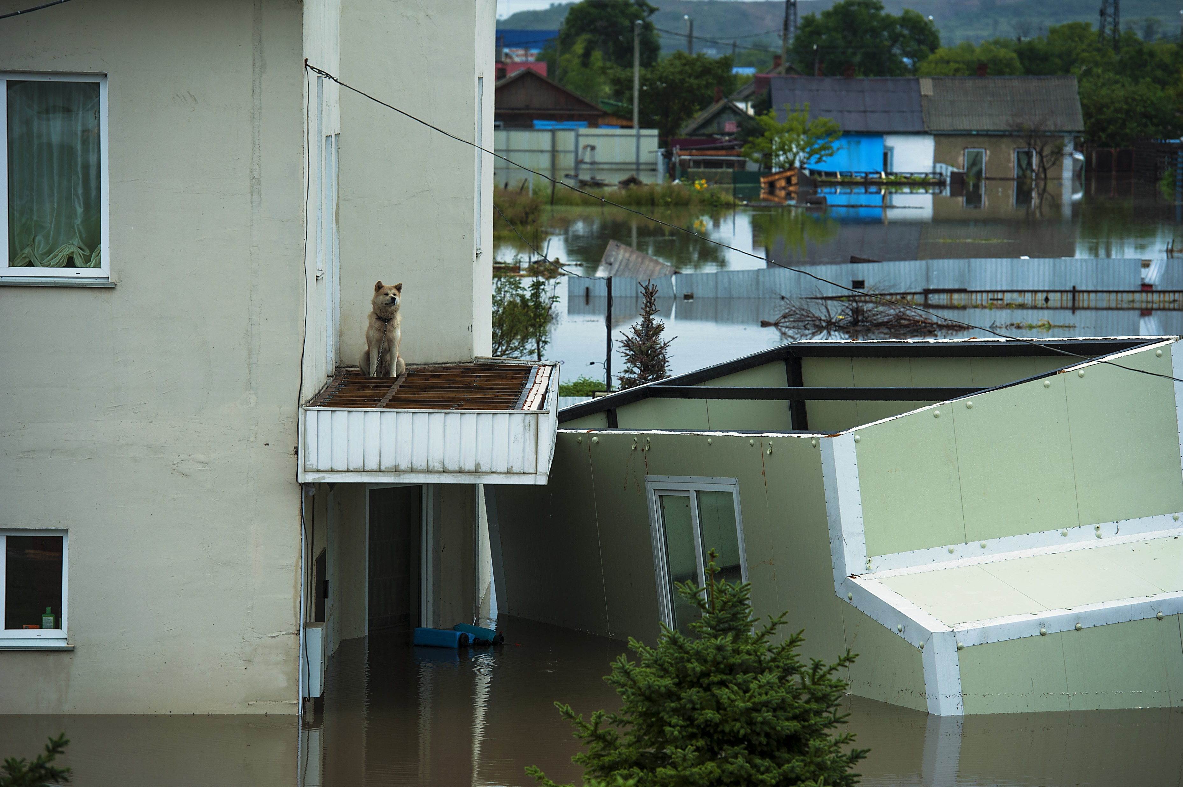

Slide 24
Discovery 3
Investigative Phenomenon

Slide 25
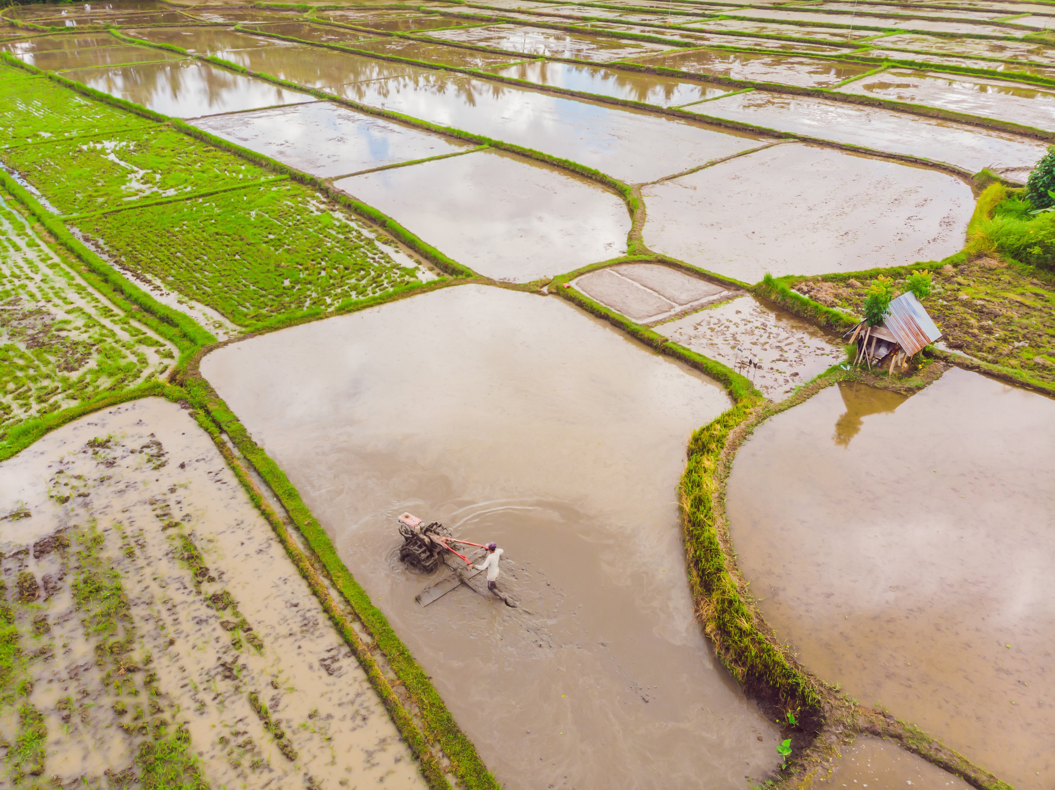

Slide 26
Discovery 4
Investigative Phenomenon

Slide 27
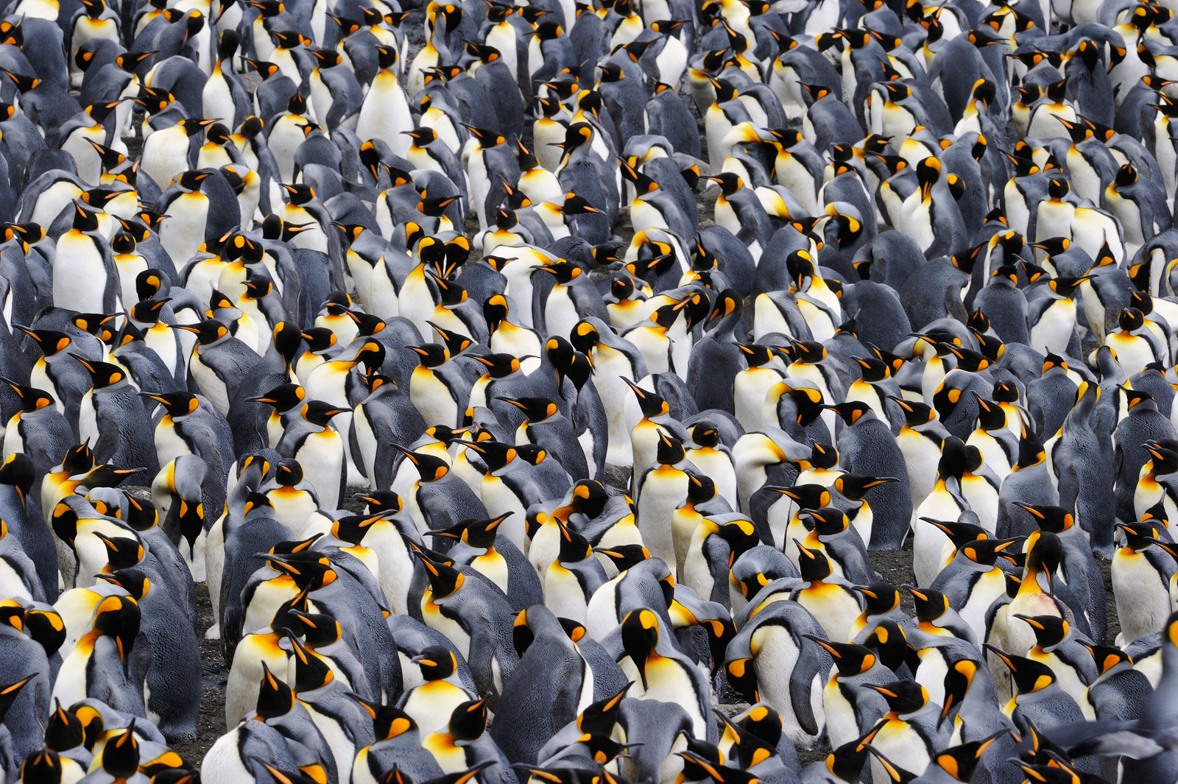
BBC News “Time lapse Shows How Penguins Huddle”
https://www.bbc.com/news/av/science-environment-13616780
Notes:
https://www.bbc.com/news/av/science-environment-13616780

Slide 28
Discovery 5
Investigative Phenomenon

Slide 29
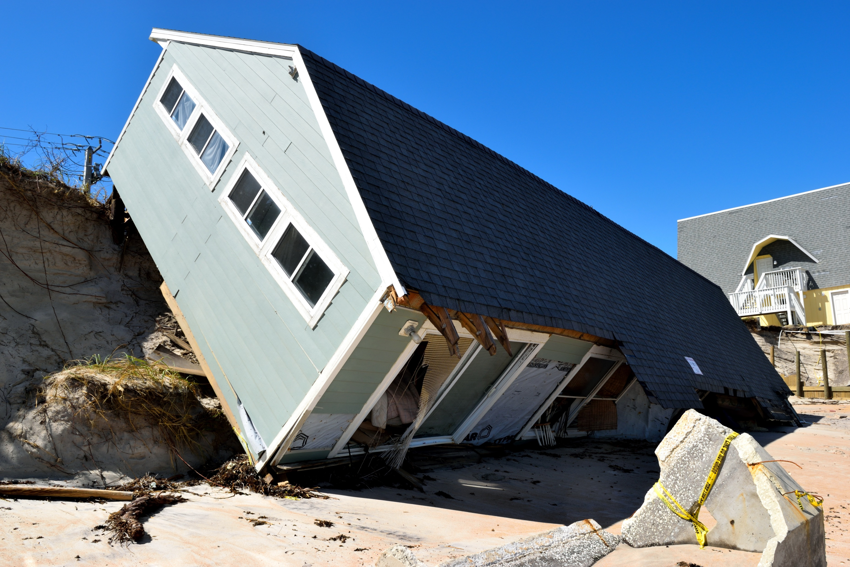

Slide 30
Module 3
Anchor Phenomenon

Slide 31
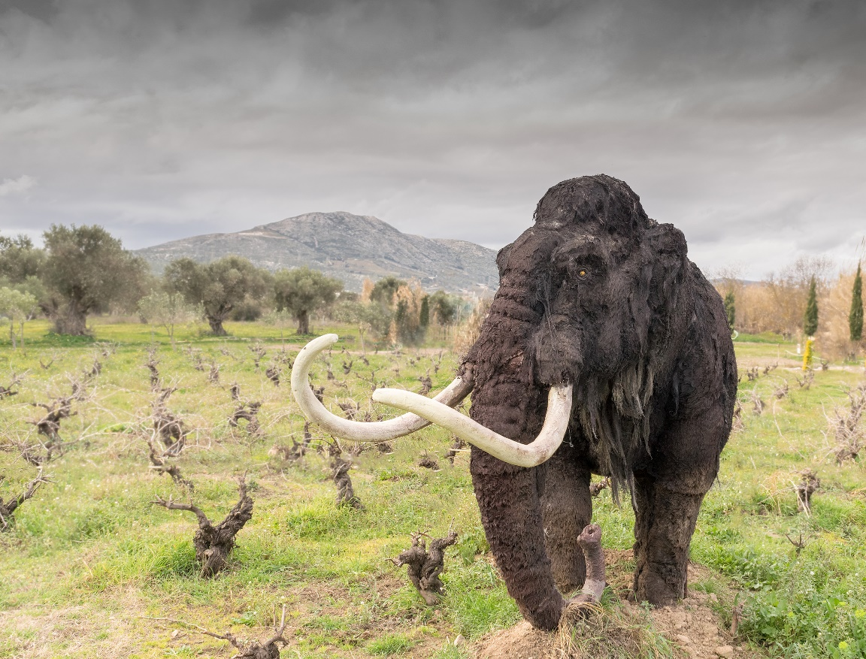

Slide 32
Discovery 1
Investigative Phenomenon

Slide 33
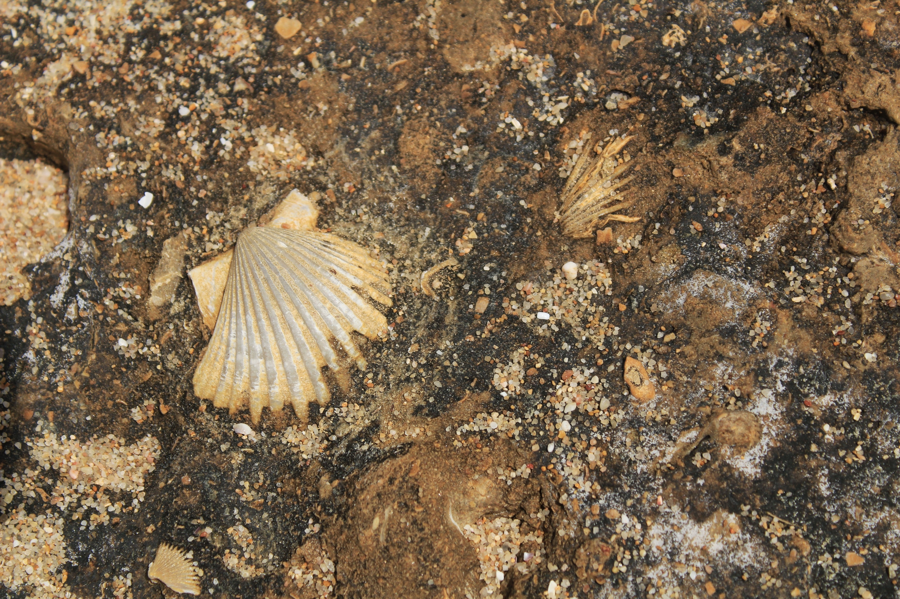

Slide 34
Discovery 2
Investigative Phenomenon

Slide 35


Slide 36
Discovery 3
Investigative Phenomenon

Slide 37
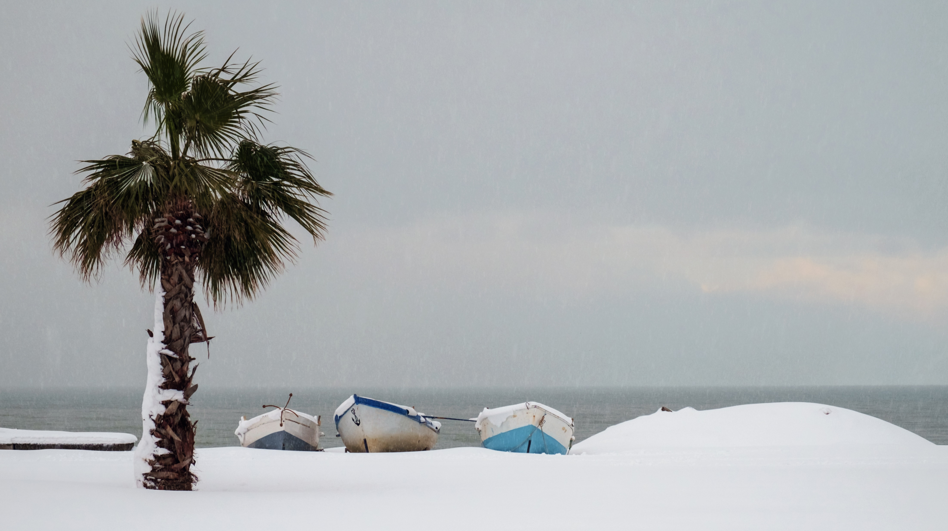

Slide 38
Discovery 4
Investigative Phenomenon

Slide 39
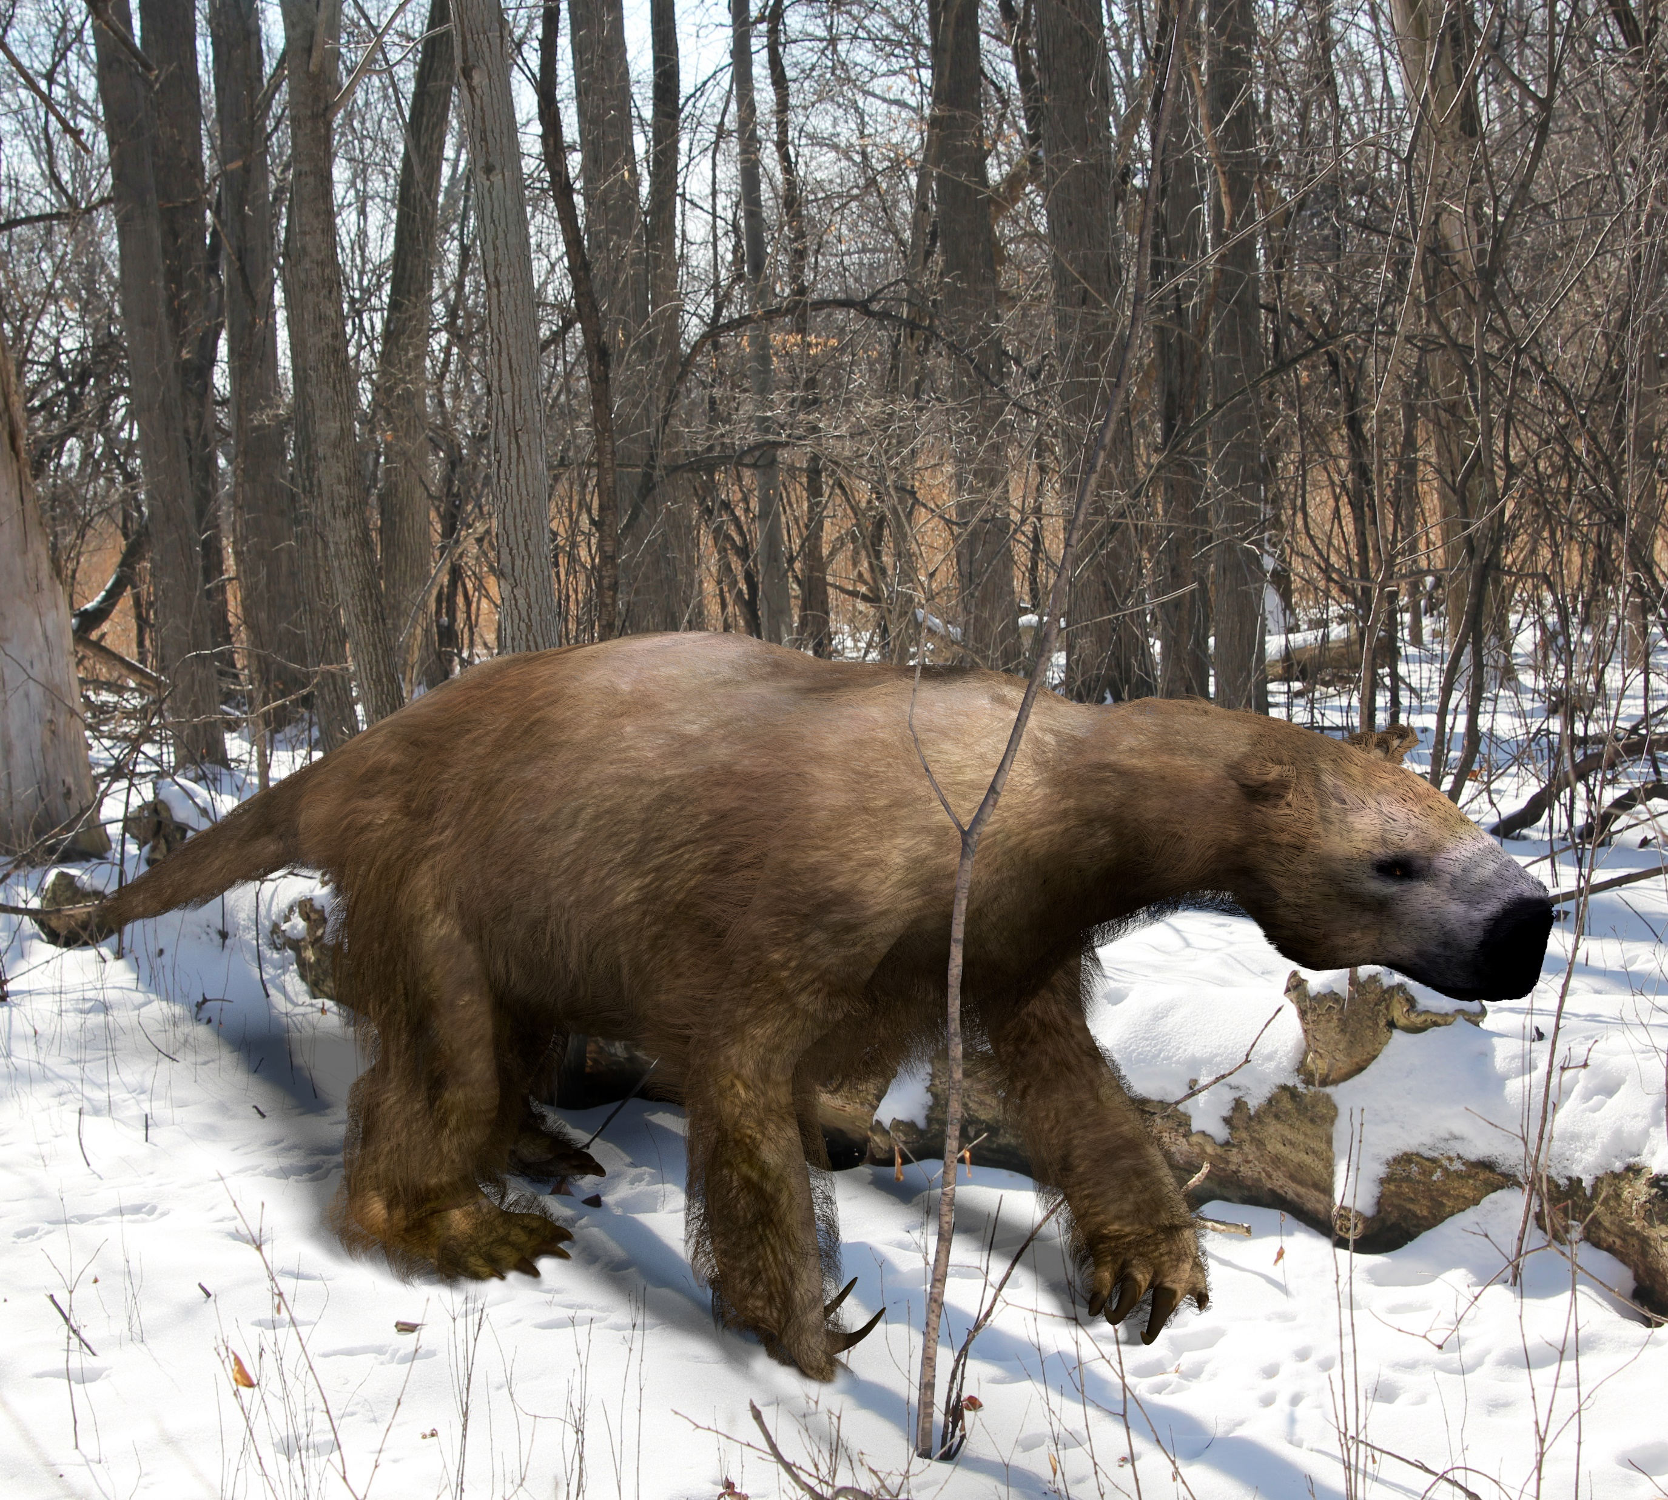

Slide 40
Discovery 5
Investigative Phenomenon

Slide 41
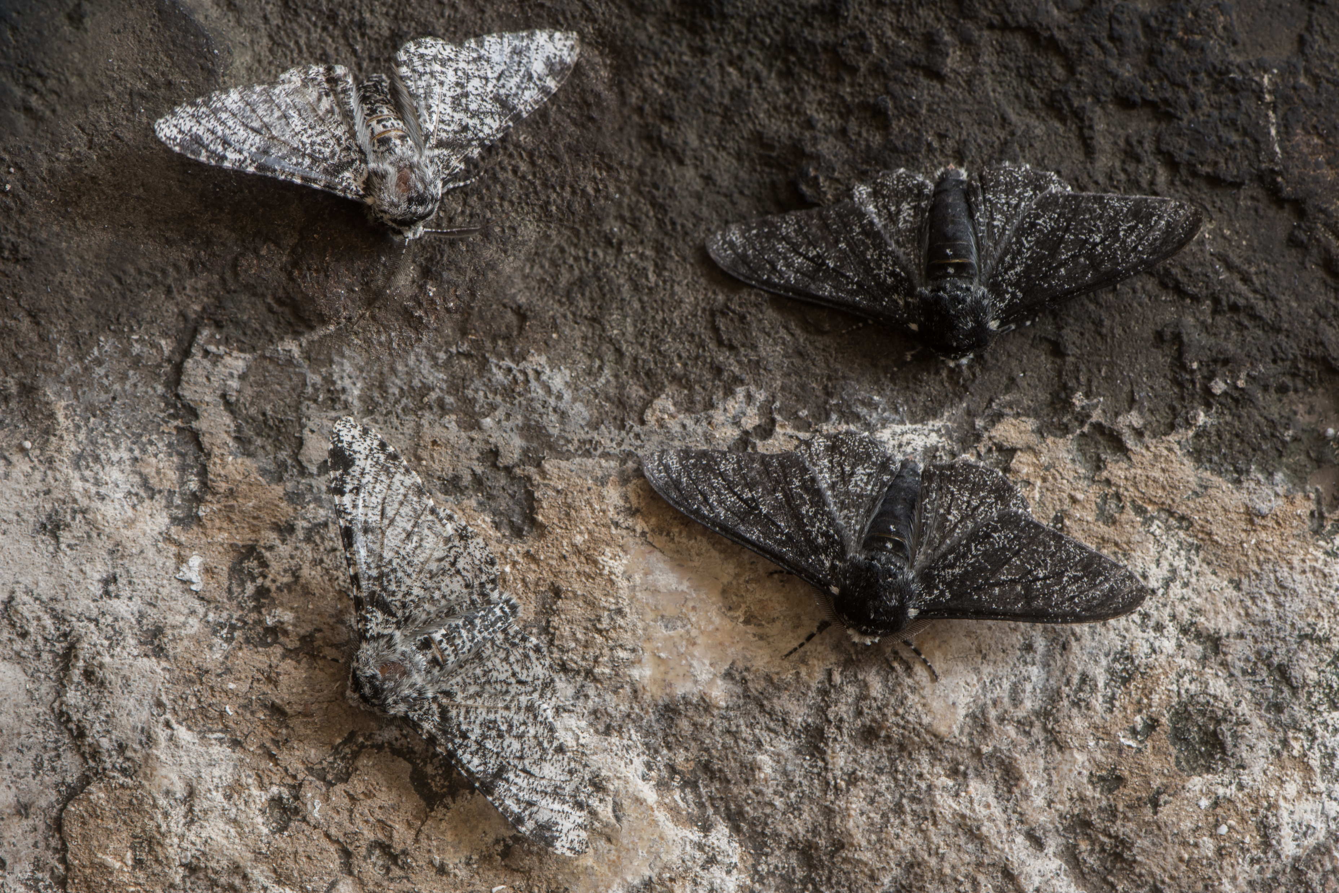

Slide 42
Module 4
Anchor Phenomenon

Slide 43
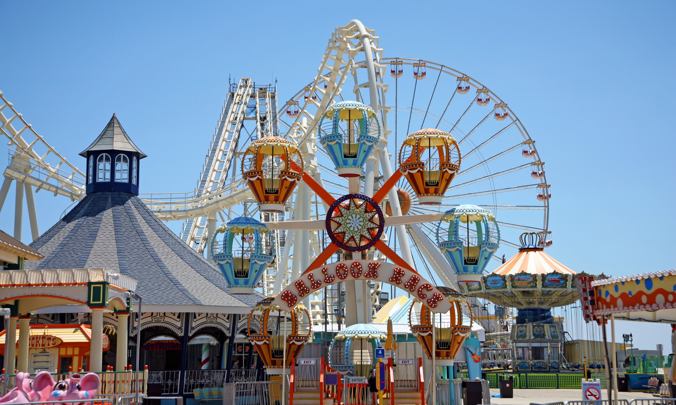

Slide 44
Discovery 1
Investigative Phenomenon

Slide 45
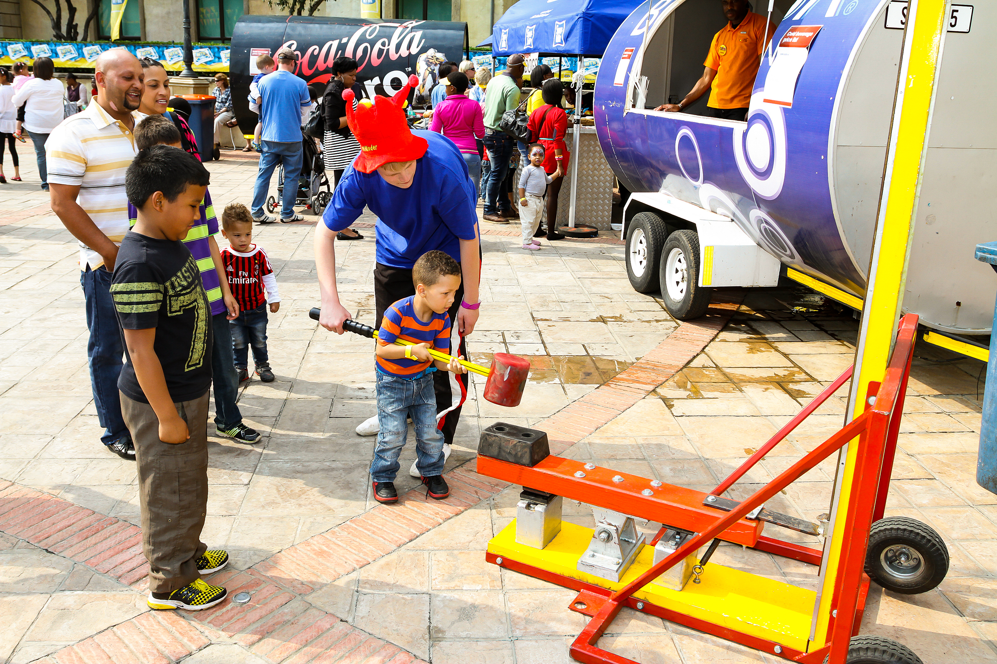
Sky High Party Rentals, "High Striker Carnival Game Rentals"
https://youtu.be/exj2e4XI5_0?t=24

Slide 46
Discovery 2
Investigative Phenomenon

Slide 47
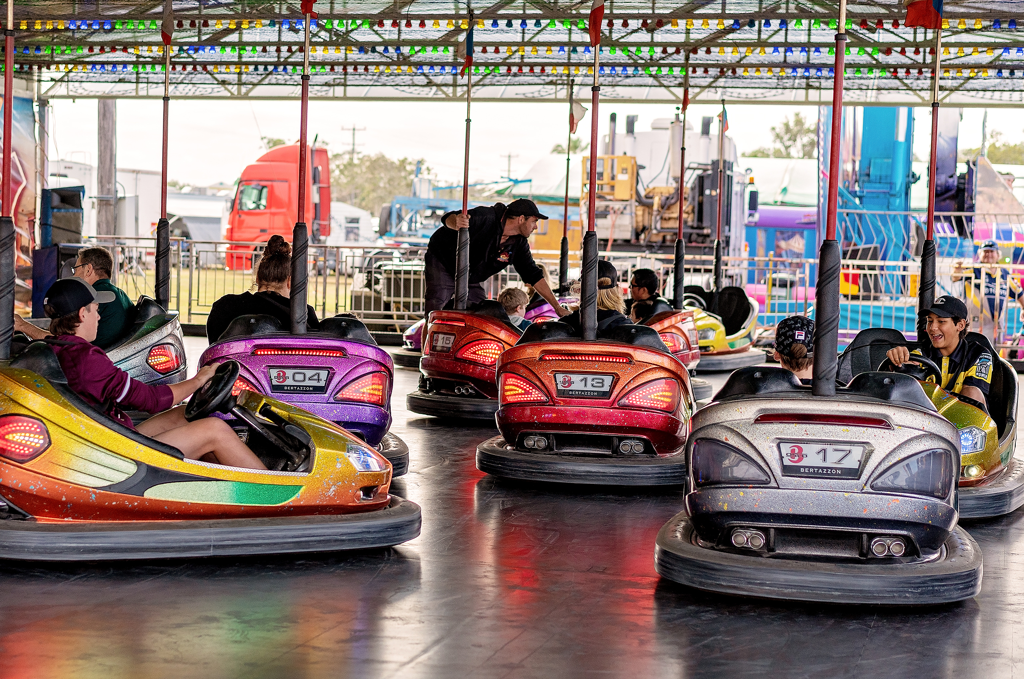
Anthony Wings, “Autoscontro - funny cars crash - bumper cars”
https://www.youtube.com/watch?v=4vZtfh0NjQg

Slide 48
Discovery 3
Investigative Phenomenon

Slide 49
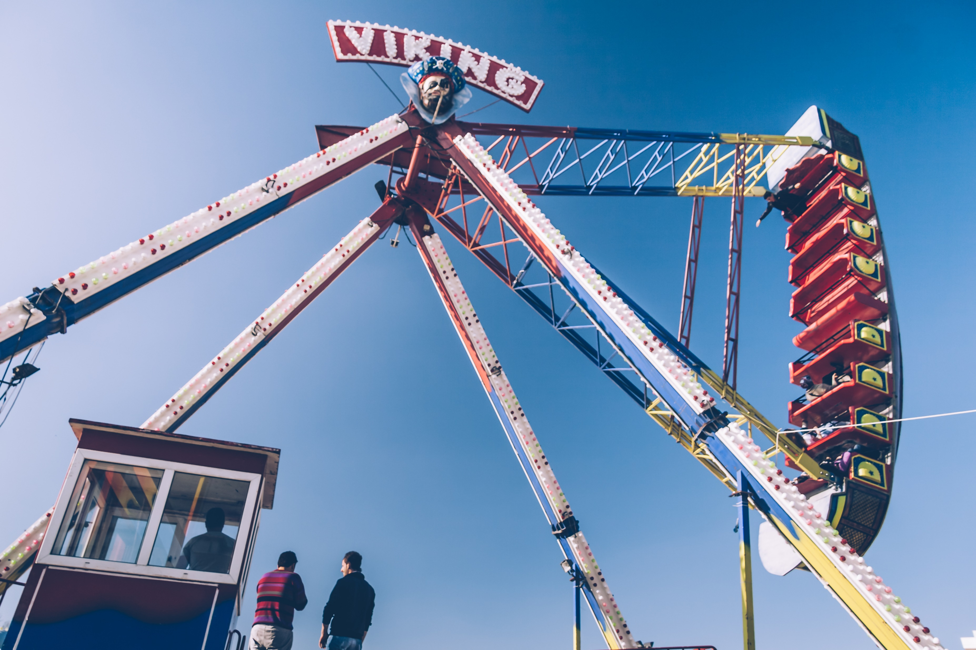
davidjesslis, "Viking Pirate Ship"
https://www.youtube.com/watch?v=GNR6POsGla8&t=99

Slide 50
Discovery 4
Investigative Phenomenon

Slide 51
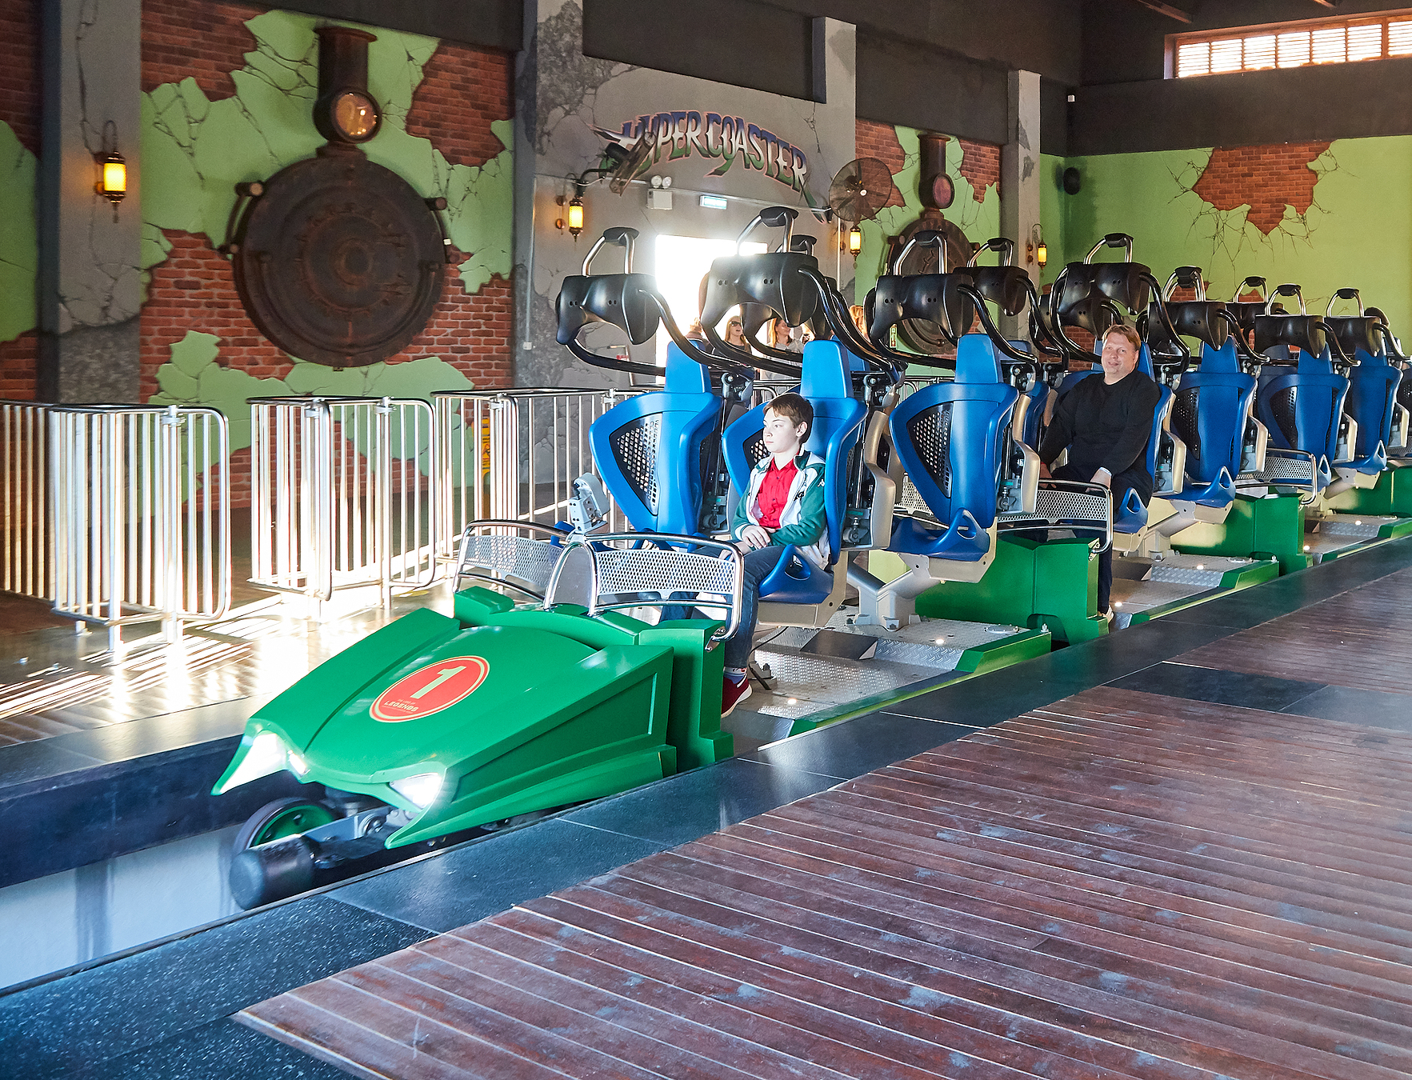
DomDoesCoasters, "Satisfying Magnetic Brake Compilation"
https://www.youtube.com/watch?v=5fWCHVm1XxE

Slide 52
Discovery 5
Investigative Phenomenon

Slide 53
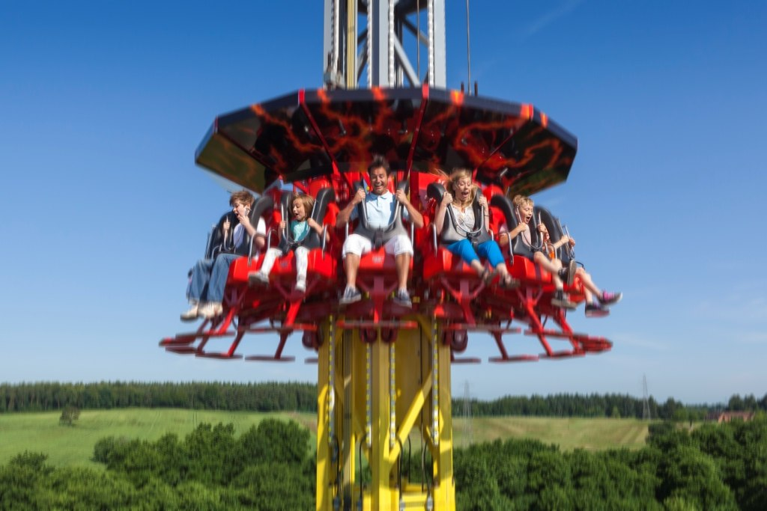
Kings Island, "Drop Tower At Kings Island"
https://www.youtube.com/watch?v=WIE98unEn4Y

